Slide 1
Review of Musculoskeletal test
Good grief people!

Slide 2
What are these descriptions of?
flexion and extension
dorsiflexion and plantarflextion
circumduction

Slide 3
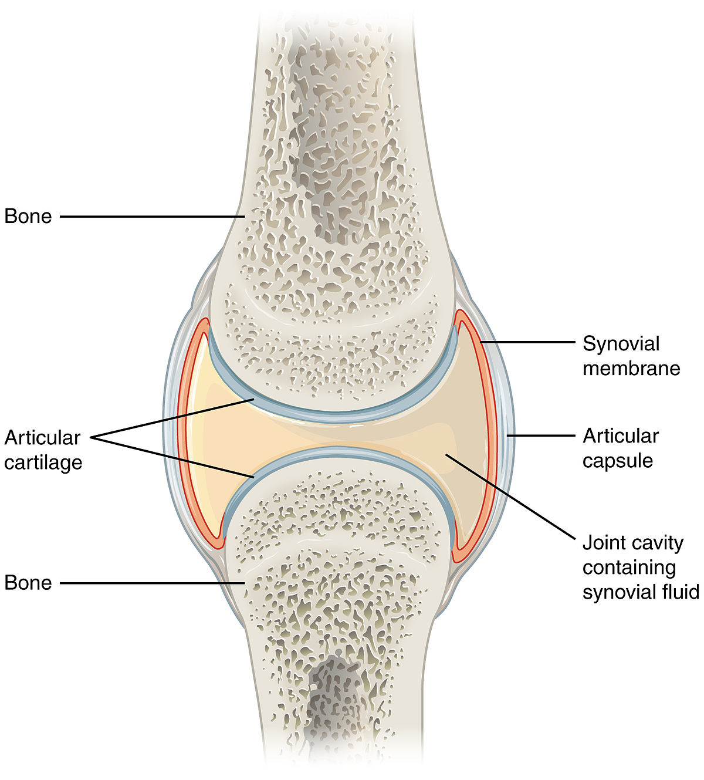
Is this a picture of a long bone?

Slide 4
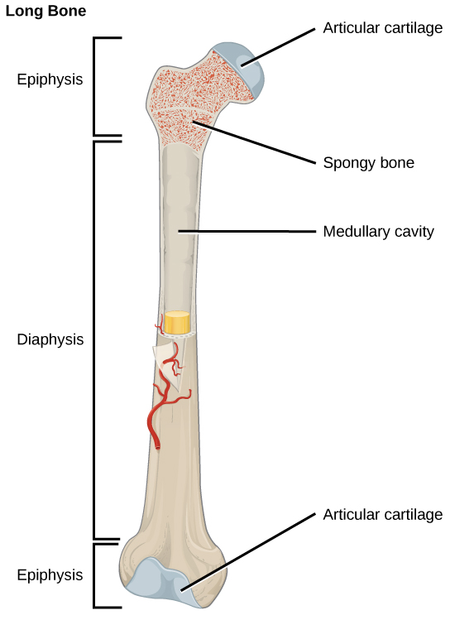
Draw and label a long bone

Slide 5
Spelling
Phosphers
Antoigonis
Acticular
Intercollated disks
Adduction x 2
myofilament
fex and extenu
the A and I model thing
intercollated

Slide 6
What were you thinking?
Are tendons types of muscles?
Is cartilage a type of ligament?
Are muscles

